Slide 1
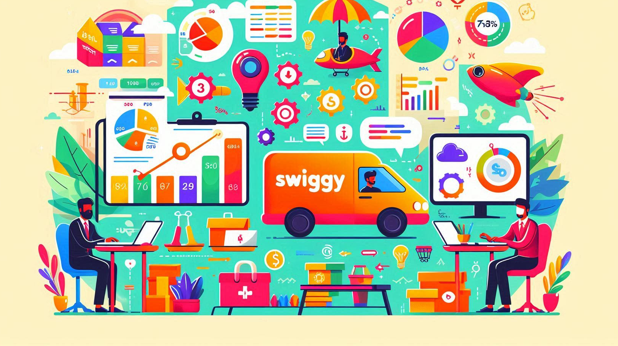


SWIGGY ANALYSIS
Restaurant Analysis Using Power BI

Slide 2
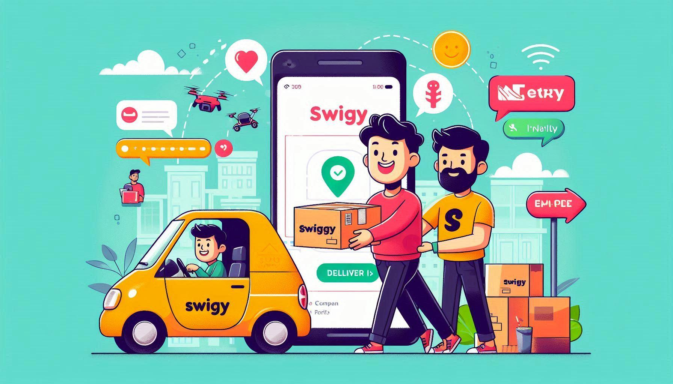

The aim is to analyze and visualize restaurant data to extract meaningful insights that can help in making informed business decisions.
I used Power BI to create interactive dashboards showcasing various aspects of the restaurant's performance.

Slide 3

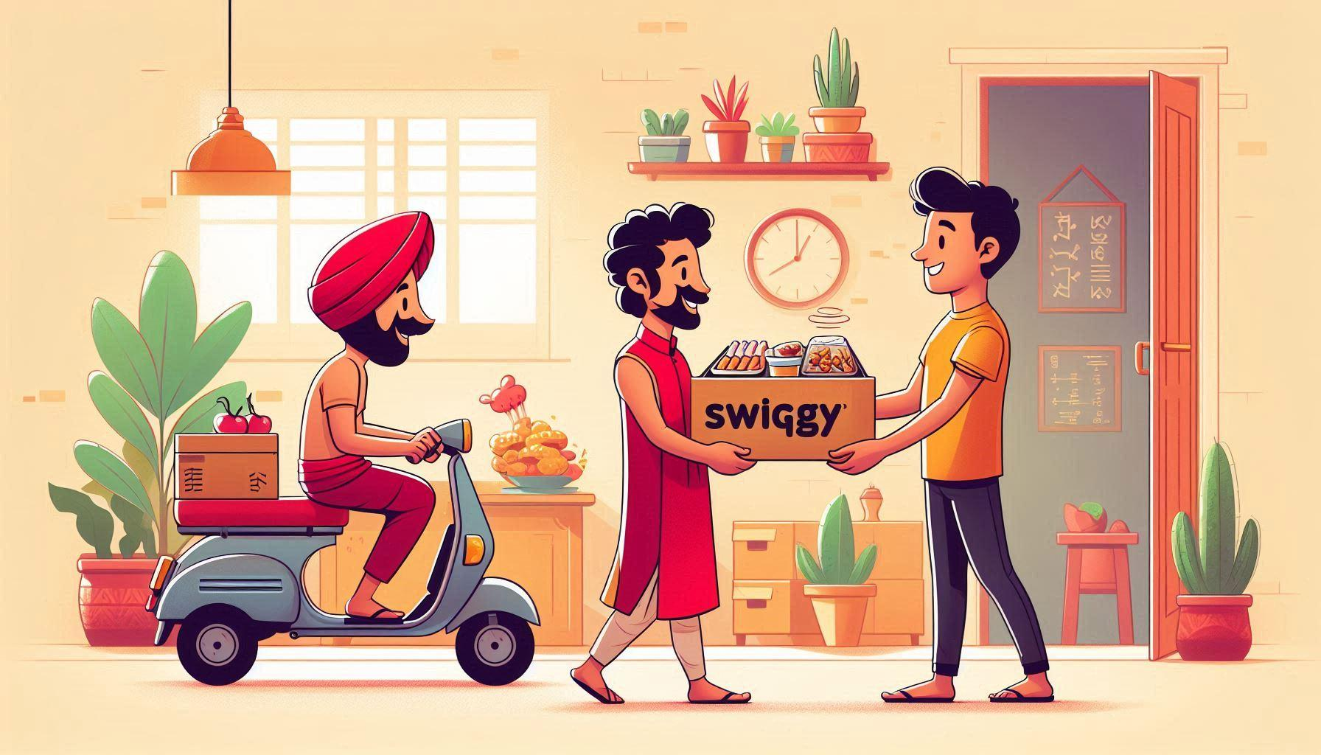
Customer Insights
Operational Efficiency
Market Positioning
Competitive Analysis
Decision Support

Slide 4

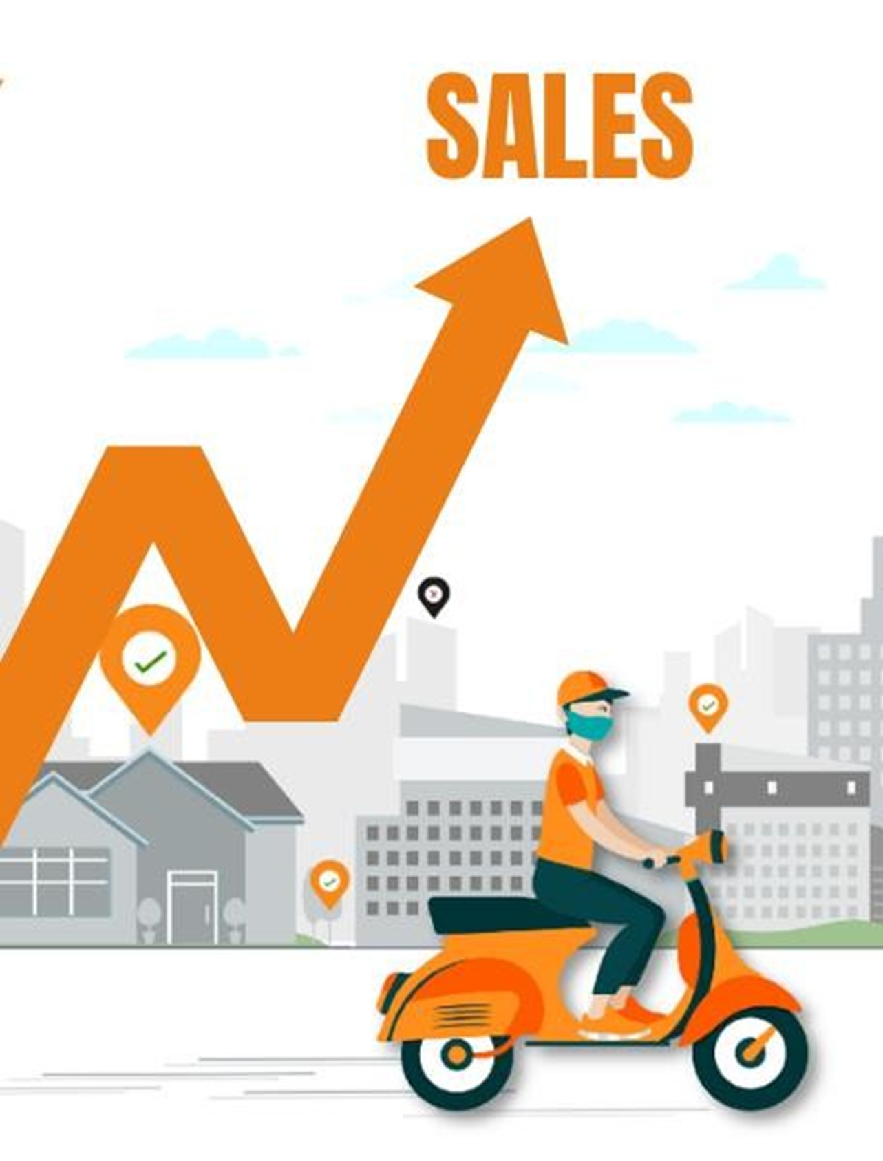
•Data Exploration
•Data Cleaning
•Data Transformation
•Visualization
•Dashboard Creation
•Analysis and Insights

Slide 5


1.Top 10 Areas with Most Restaurants
2.Most Popular Food Types Served by Swiggy
Restaurants in Each City
3.Top Rated Swiggy Restaurants
4.Correlation of Factors Affecting Average Rating
5. Correlation Between Restaurant Price and Average Rating
6.City-wise Restaurant Count.

Slide 6
7.Price Analysis
8.Delivery Time Analysis
9.Cuisine Analysis
10.Area-wise Restaurant Analysis
11.Correlation Analysis
12.Customer Feedback Analysis
13.Geographical Mapping

Slide 7

Company Profile: Swiggy
Key Points:
Founded: 2014
Headquarters: Bengaluru, India
Services: Food delivery, grocery delivery, instant grocery delivery
Mission: To connect customers to the best food and deliver it fast
Impact:
Revolutionized the food delivery industry in India
Empowered local restaurants
Created numerous employment opportunities
Enhanced customer convenience and experience
Key Achievements:
Expanded operations to major cities across India
Partnered with thousands of restaurants and grocery stores
Introduced innovative features like Instamart for quick grocery delivery
Achieved significant growth in user base and order volume
Raised substantial funding to fuel expansion and innovation
Vision:
To be the leading food delivery and quick commerce platform in India, providing a seamless and delightful experience for customers, partners, and delivery partners.

Slide 8

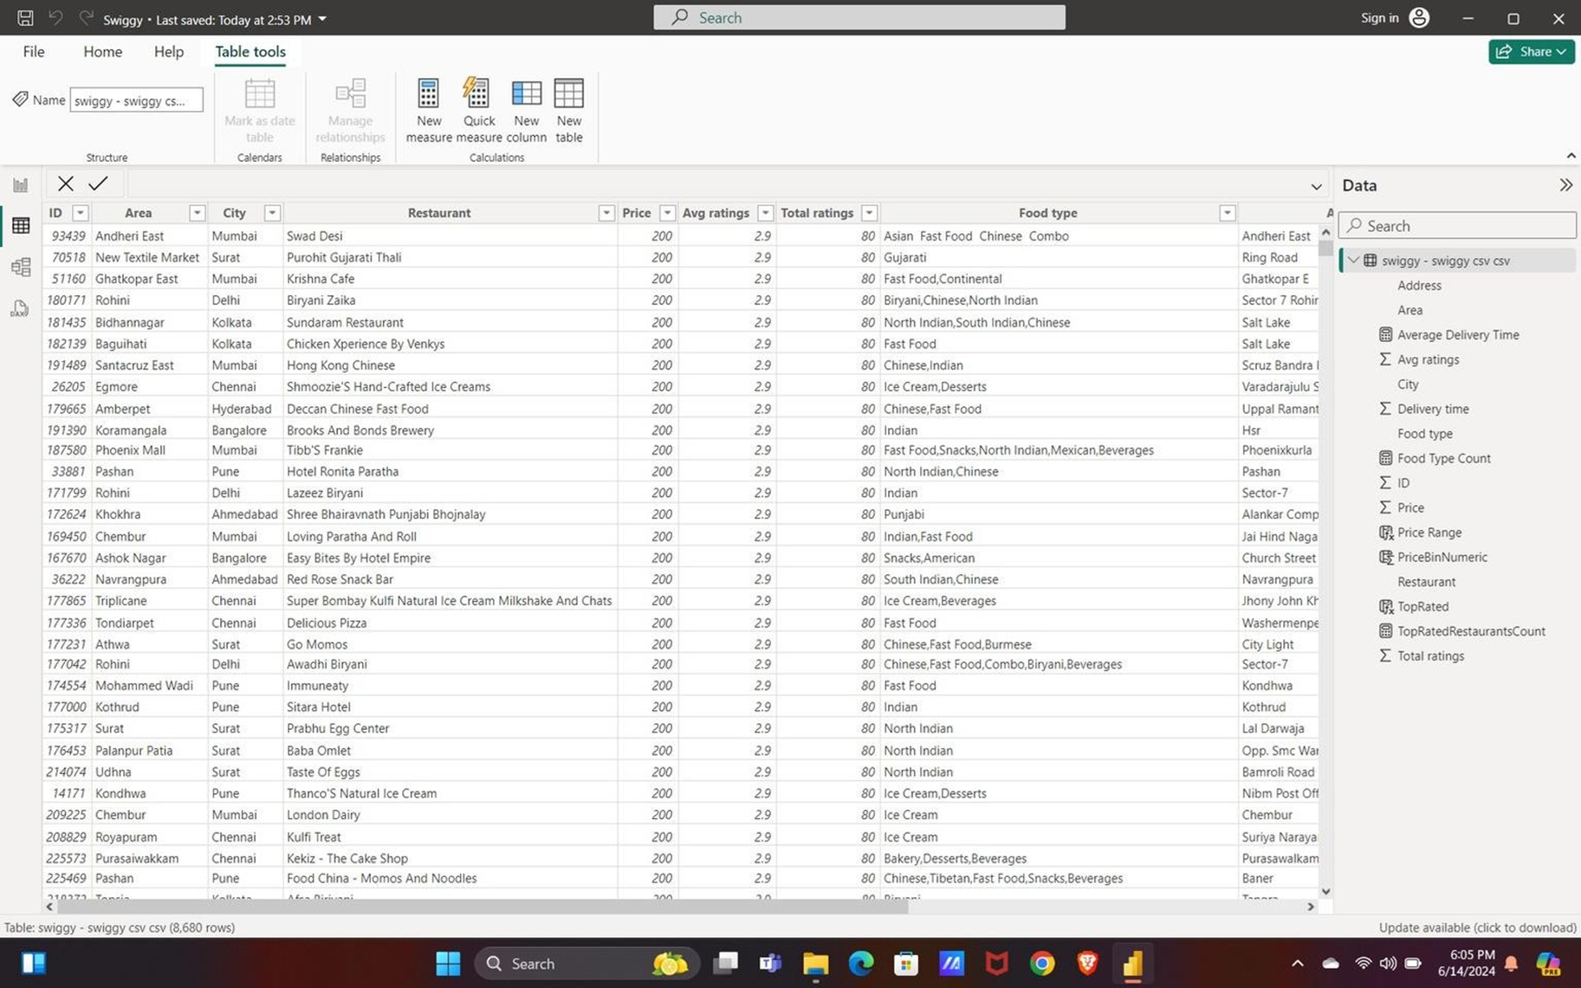
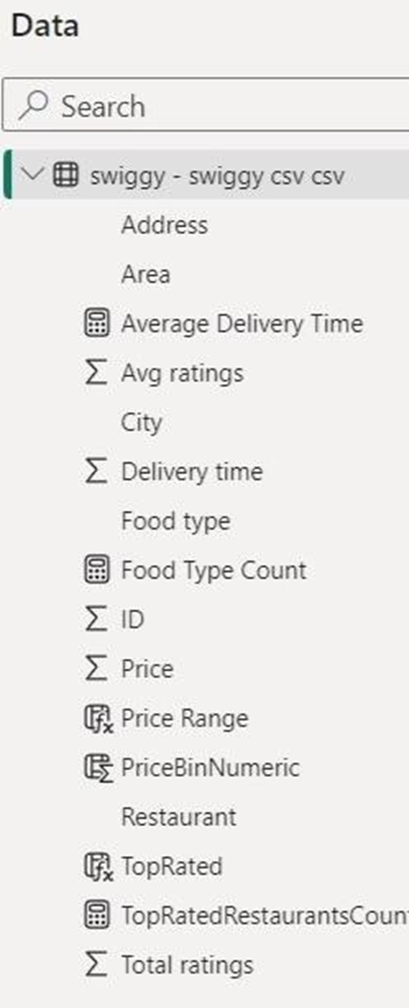

Slide 9
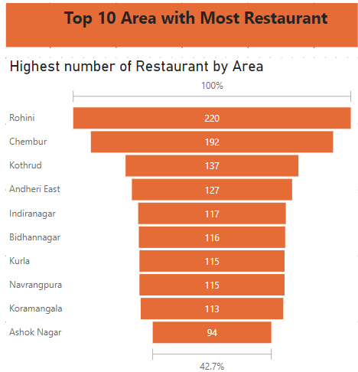
1.Top 10 Areas with Most Restaurants
Task 1: Top 10 Areas with Most Restaurants
The top 10 areas with most restaurants are shown in the Funnel Charts
From this, I found that the area Rohini in Delhi holds the 1st place with 220 hotels, averaging a rating of 3.38..

Slide 10
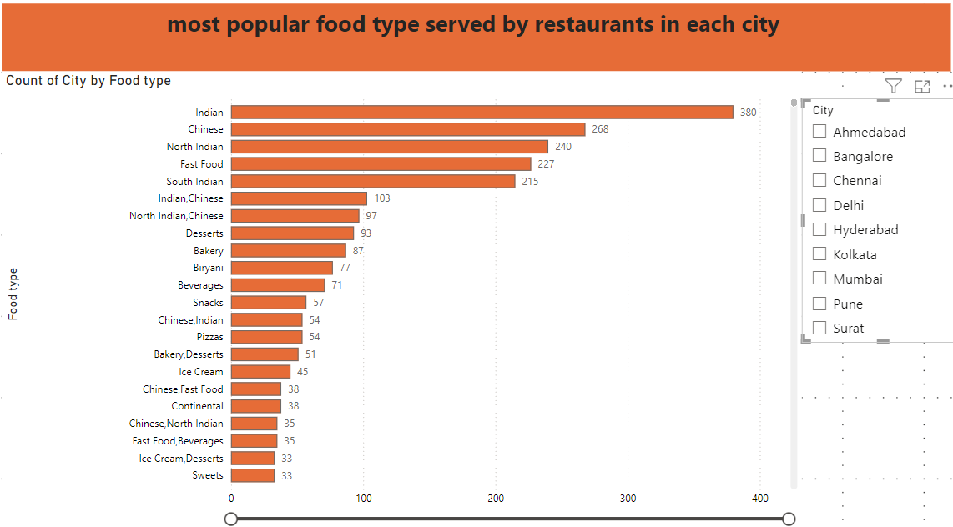
Most Popular Food Types Served by Swiggy Restaurants in Each City Analysis :
The most popular food types served by Swiggy Restaurants in each city are shown in a stacked column chart.
From this Indian food types hold the majority of the city.

Slide 11
Most Popular Food Types Served by Swiggy Restaurants in Each City Analysis :
(Indian)Ahmedabad is well-known for its wide variety of Indian food, particularly Gujarati fare.
Bangalore (South India): is well-known for its dosas and idlis.
Chennai (Indian) Indian city of Chennai is well-known for its extensive selection of Tamil-style South Indian food.
Delhi (North Indian): This city serves a range of North Indian dishes, including as street food and biryani.
(South Indian )city of Hyderabad is well-known for its biryani and other regional specialties.
Kolkata, ( Indian) city, is well-known for its Bengali food, which includes fish dishes and sweets.
(Chinese) Mumbai is well-known for its street food adaptations of Chinese cuisine.
Pune (Chinese): Like Mumbai, Pune boasts a sizable Chinese culinary community.
Surat (Fast Food) is known for its thriving fast food scene, which includes a variety of regional munchies.

Slide 12
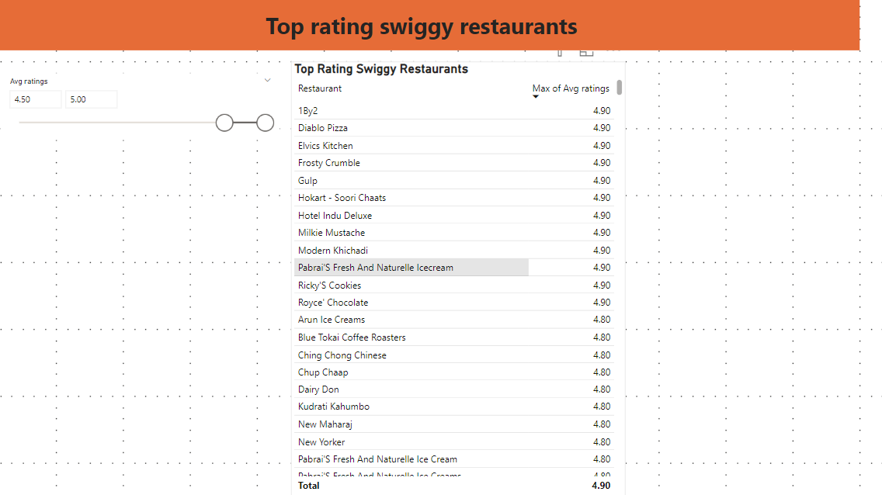
Top Rated Swiggy count of Top-Rated Restaurants Analysis :
Over 545 restaurants have the highest number of ratings, ranging from 4.5 to 5.00. This constitutes 6.92% of the total restaurants, with most of these top-rated restaurants located in Bangalore and Mumbai.

Slide 13
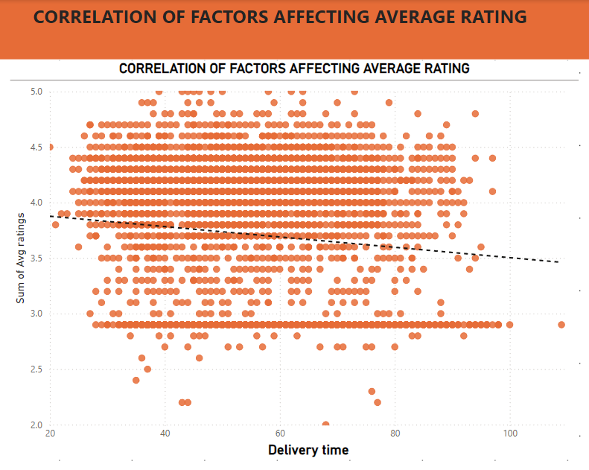
Correlation of Factors Affecting Average Rating Analysis :
The correlation of price affecting the average rating is shown in the scatter plot.
From this, I found that the delivery time is affecting the average rating. That is, if the delivery time increases, then the average rating will decrease. The trendline clearly shows this downward trend.

Slide 14
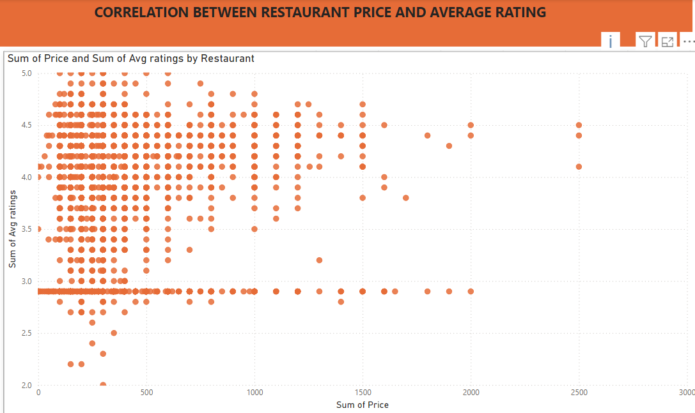
Correlation of Price Affecting Average Rating
Analysis:
The correlation of price affecting average rating is shown in the scatter plot.
From this, I found that the price is directly proportional to the average rating. That is, if the price increases, then the average rating will also increase, as shown by the upward trendline.

Slide 15
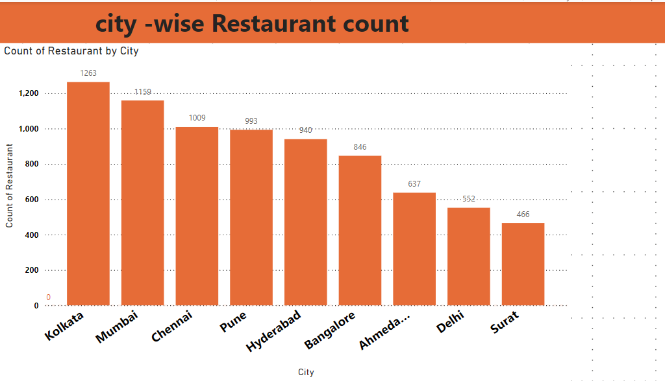
City-wise Restaurant Count Analysis:
The count of restaurants in each city is plotted in a stacked column chart.
From this, I found that Kolkata holds the 1st place with 1263 restaurants, averaging a rating of 3.70.

Slide 16
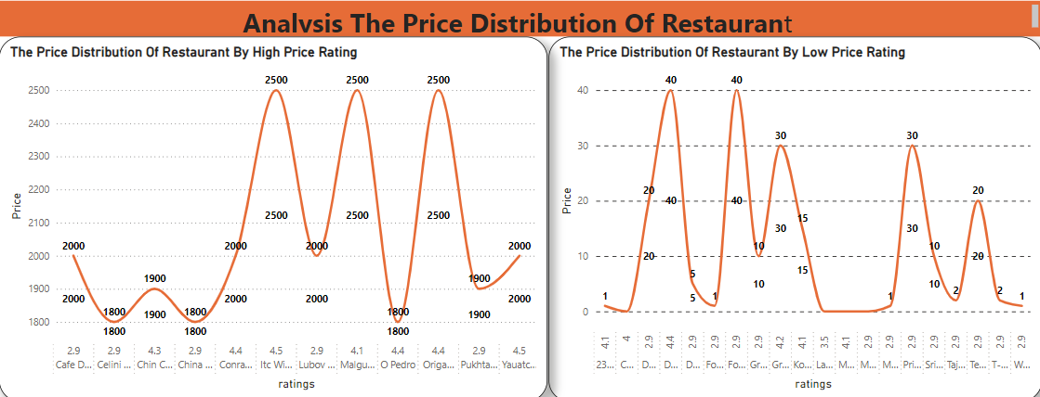

Slide 17
Price Analysis
The Price Distribution of Restaurants
Ratings and High Prices:
The top-rated restaurants generally have high prices, indicating that customers are willing to pay more for quality dining experiences. For example, ITC Windsor Gourmet Couch, Yauatcha, and O Pedro, all have high average ratings (4.5, 4.5, and 4.4 respectively) and high prices (₹2500, ₹2000, and ₹1800 respectively)
Correlation Between Price and Rating:
Not all high-priced restaurants have high ratings. Some, like Cafe Delhi Heights and Lubov Patisserie, have lower average ratings of 2.9 despite having high prices of ₹2000. This suggests that higher prices do not always guarantee higher customer satisfaction

Slide 18
Bottom 10 Price Distribution
Low Prices and Diverse Ratings: The bottom 10 restaurants have significantly lower prices, mostly around ₹50 or less. Despite the low prices, some of these establishments maintain high ratings, like Taiyar Pan Center (4.6) and Cane Fresh (4.4), indicating good value for money and customer satisfaction.
Mixed Quality Perception: Many low-priced restaurants have lower ratings, around 2.9, suggesting that while affordability is a factor, it often comes with a compromise on quality or service.

Slide 19
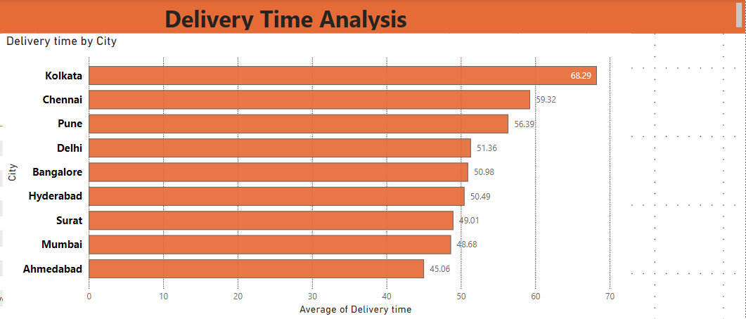
Delivery Time Analysis
Analysis:
The average delivery time of foods by city-wise is plotted in clustered bar chart.
From this, I found that, Ahmedabad holds lesser time in delivering food with avg delivery time of 45 minutes with avg rating of 3.60.

Slide 20
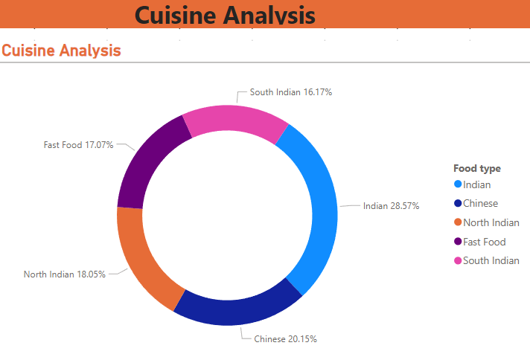
The top 5 cuisine is plotted
in donut chart Analysis:
From this, I found that,
Indian cuisine holds the 1st
place with 28.57% avg
rating of 3.54.

Slide 21
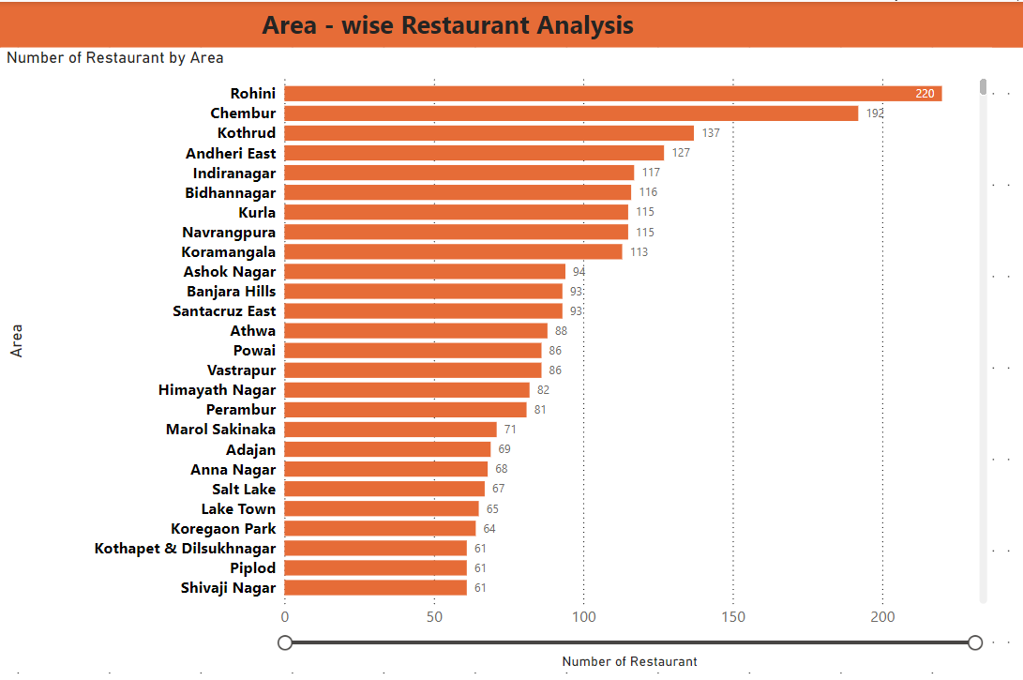
Area-wise Restaurant Analysis
The restaurants with area-
wise is plotted in clustered
bar chart.
From this, I found that, the
area - Rohini from Delhi
holds the 1st place with 220
number of hotels with average
rating of 3.38.

Slide 22
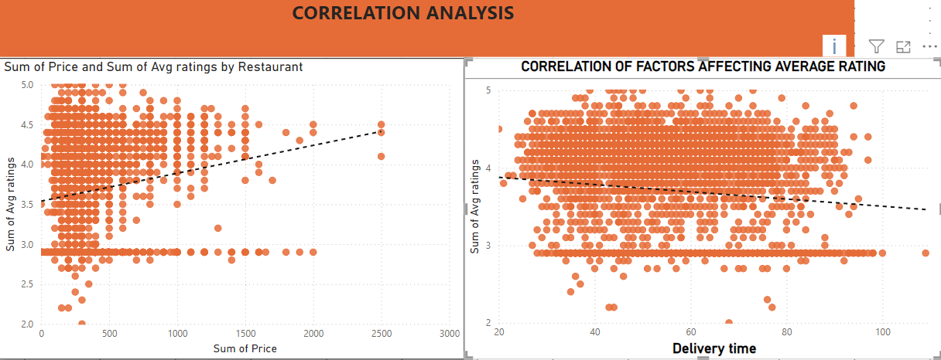
if price increases then the average rating will also increase, the trendline shows it clearly by moving upwards.
if delivery time increases then the avg rating will decreases, the trendline shows it clearly by moving downwards.

Slide 23
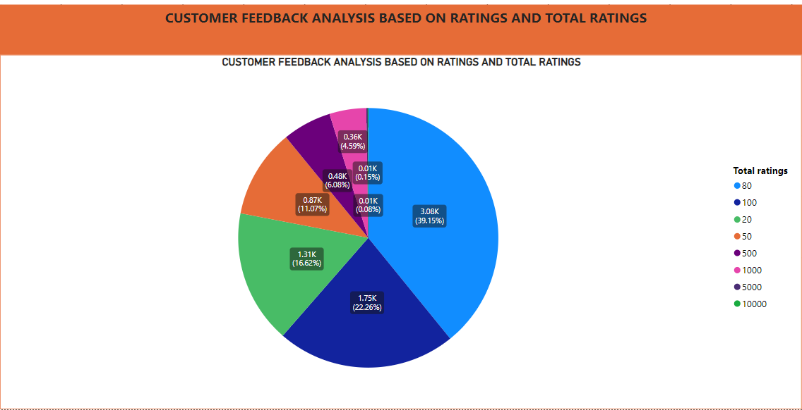

Slide 24
CUSTOMER FEEDBACK ANALYSIS BASED ON RATINGS AND TOTAL RATINGS
High Engagement:(total number individual rating )
80 Ratings: 3,079 total ratings; indicates significant customer engagement.
100 Ratings: 1,751 total ratings; reflects strong feedback and participation.
Moderate Engagement:
20 Ratings: 1,307 total ratings; shows notable customer attention.
50 Ratings: 871 total ratings; reasonable feedback, though less than higher ratings.
500 Ratings: 478 total ratings; suggests moderate feedback, with fewer responses compared to more popular categories
Low Engagement:
1,000 Ratings: 361 total ratings; reflects lower engagement for businesses with an average rating of 1,000.
5,000 Ratings: 12 total ratings; indicates very limited feedback, suggesting a niche market or low customer engagement for businesses with an average rating of 5,000.
10,000 Ratings: 6 total ratings; represents extremely limited feedback, implying very specialized businesses or very low customer engagement for an average rating of 10,000.
.
.

Slide 25
CUSTOMER FEEDBACK ANALYSIS BASED ON RATINGS AND TOTAL RATINGS
High Engagement:(total number individual rating )
80 Ratings: 3,079 total ratings; indicates significant customer engagement.
100 Ratings: 1,751 total ratings; reflects strong feedback and participation
Moderate Engagement:
20 Ratings: 1,307 total ratings; shows notable customer attention.
50 Ratings: 871 total ratings; reasonable feedback, though less than higher ratings.
500 Ratings: 478 total ratings; suggests moderate feedback, with fewer responses compared to more popular categoriesLow Engagement:
1,000 Ratings: 361 total ratings; reflects lower engagement for businesses with an average rating of 1,000.
5,000 Ratings: 12 total ratings; indicates very limited feedback, suggesting a niche market or low customer engagement for businesses with an average rating of 5,000.
10,000 Ratings: 6 total ratings; represents extremely limited feedback, implying very specialized businesses or very low customer engagement for an average rating of 10,000.
.
.

Slide 26
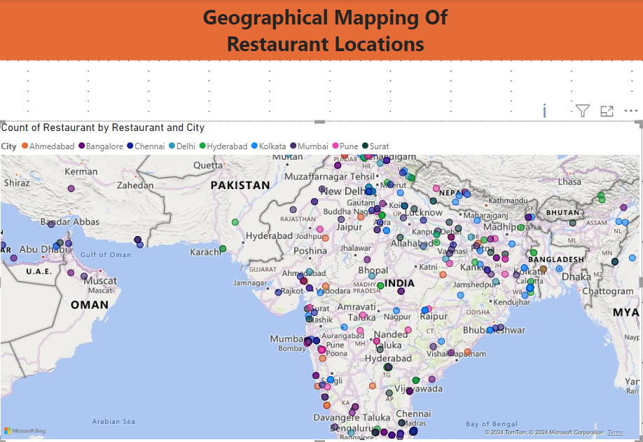
Analysis:
The geographical mapping
is shown in map and all the
cities are highlighted by
mark with highlighted
city names and restaurant location.

Slide 27
1. Focus on High-Density Areas:
Finding: Rohini in Delhi has the highest number of restaurants (220) with an average rating of 3.38.
Recommendation: Consider targeted marketing campaigns and partnerships in Rohini to leverage the high restaurant density. Additionally, work on improving the average rating through quality checks and customer feedback
2 .Promote Popular Food Types:
Finding: Indian food types hold the majority across cities
Recommendation: Enhance promotions for Indian cuisine, potentially offering special deals or highlighting top-rated Indian restaurants. This can attract a larger customer base and improve overall satisfaction

Slide 28
3. Increase the Number of Top-Rated Restaurants
Finding: Only 3.73% of restaurants are top-rated with an average rating of 4.68.
Recommendation: Implement a quality improvement program to help more restaurants achieve higher ratings. This could include training for restaurant staff, regular quality audits, and incentivizing high performance.
4.optimize Delivery Time
Finding: Delivery time negatively affects average ratings.
Recommendation: Focus on optimizing delivery logistics to reduce delivery times. This could involve improving delivery route planning, increasing the number of delivery partners, and using technology to track and enhance delivery efficiency.

Slide 29
5. price and Quality Correlation:
Finding: Higher prices are associated with higher average
Ratings Recommendation: Encourage restaurants to maintain high quality standards if they charge higher prices.Educate restaurants on pricing strategies that reflect their quality and improve customer perception
6.Expand in High-Restaurant Cities:
Finding: Kolkata has the highest number of restaurants (1263)
with an average rating of 3.70.
Recommendation: Increase Swiggy's presence in Kolkata by onboarding more restaurants and running localized marketing campaigns. Address the average rating by encouraging customer reviews and feedback for continuous improvement

Slide 30
7.Price Range Insights:
• Finding: The price range between 200 to 300 holds the most restaurants.
• Recommendation: Promote restaurants within this price range to attract budget-conscious customers. Highlight deals and combos in this price range to increase customer engagement.
8.Delivery Time Benchmarking:
• Finding: Ahmedabad has the shortest delivery time (45 minutes) with an average rating of 3.60.
• Recommendation: Use Ahmedabad as a benchmark for delivery time improvements in other cities. Analyze what contributes to efficient delivery in Ahmedabad and replicate these strategies elsewhere.

Slide 31
9.Cuisines Variety:
• Finding: Indian cuisine is the most popular, with 28.47% and
• an average rating of 3.54.
• Recommendation: Diversify the cuisine offerings by promoting less popular but highly rated cuisines to provide more variety to customers. Highlight unique cuisine options to differentiate Swiggy from competitors.
10.Local Area Dominance:
Finding: Rohini in Delhi has the highest number of restaurants.
Recommendation: Deepen engagement with restaurant owners in Rohini to improve service quality and customer satisfaction. Consider exclusive offers or loyalty programs for frequent customers in this area.

Slide 32
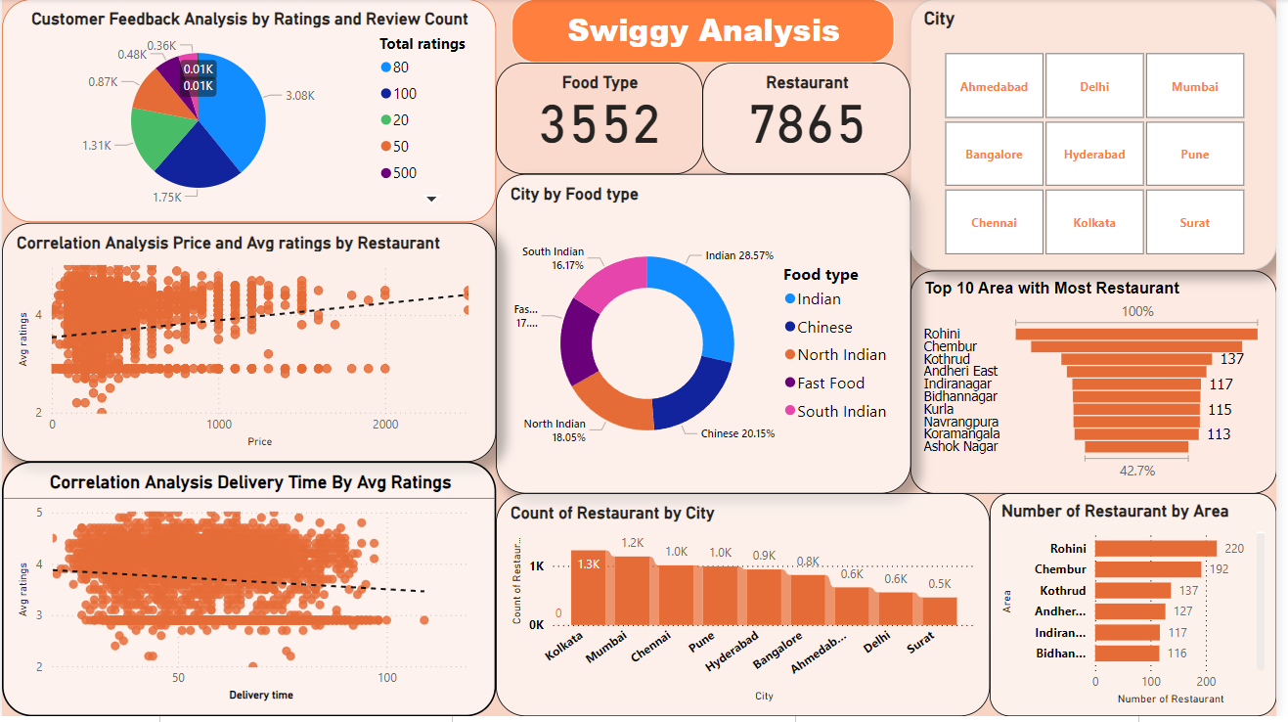
Swiggy Dashboard Analytics

Slide 33
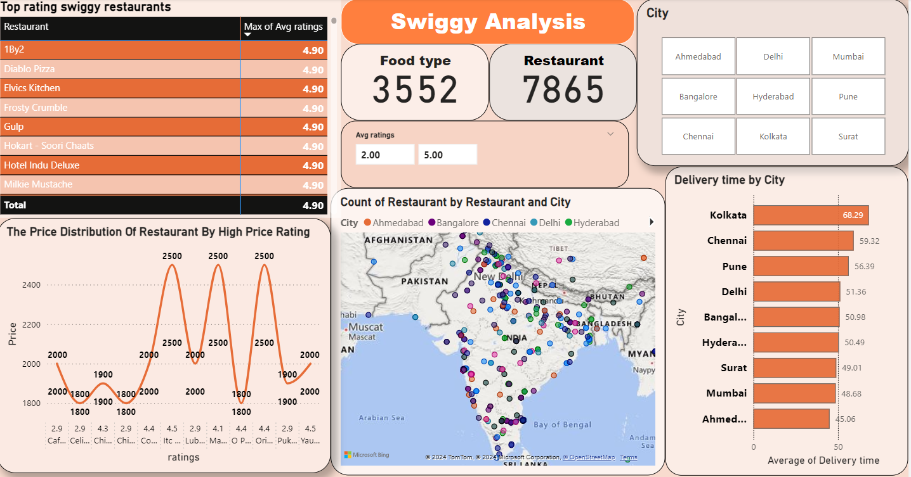
Swiggy Dashboard Analytics

Slide 34
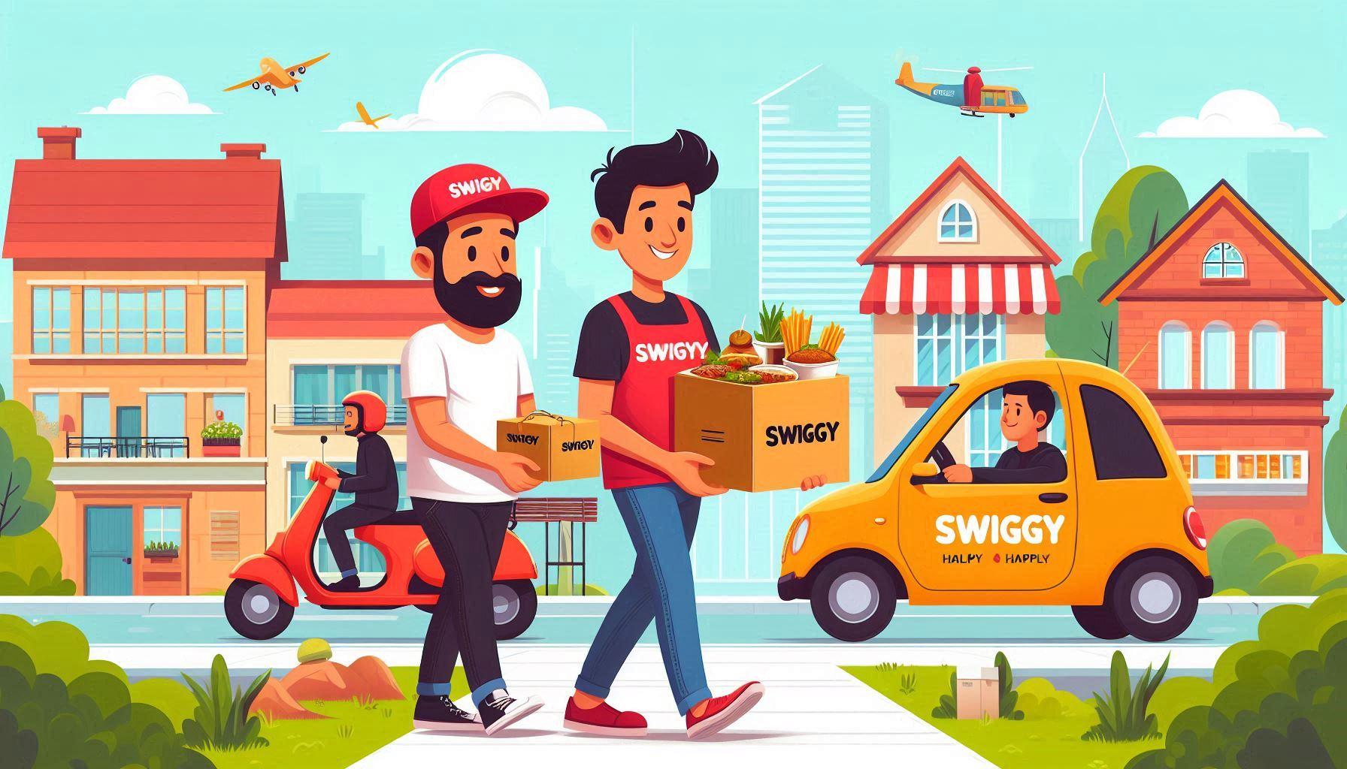
Thank You

